Slide 1
Software development process methodologies
Methodology is a set of models, methods, practices and tools.
The methodologies classified as
«Heavy»/«Formal» : RUP, MSF
«Light»/«Flexible» : Scrum, Agile, eXtreme Programming

Slide 2
Rational Unified Process
RUP — approach, which is
Iterative
Architecture centered
Use-case based
The four phases of RUP
Inception (What will be developed?)
Elaboration (How it will be developed?)
Construction (Product development)
Transition (Product delivery)
https://courses.edx.org/courses/course-v1:MEPhIx+MEPHI001x+2T2016

Slide 3
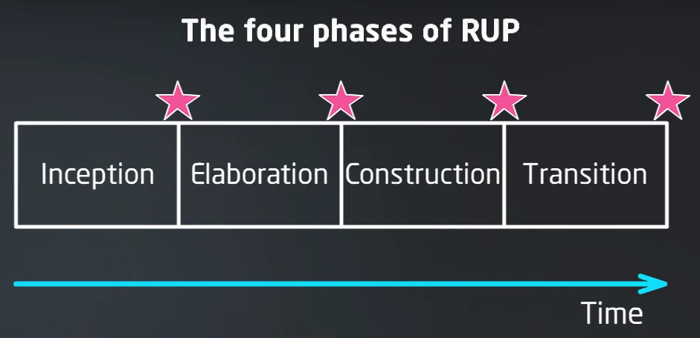
The four phases of RUP

Slide 4
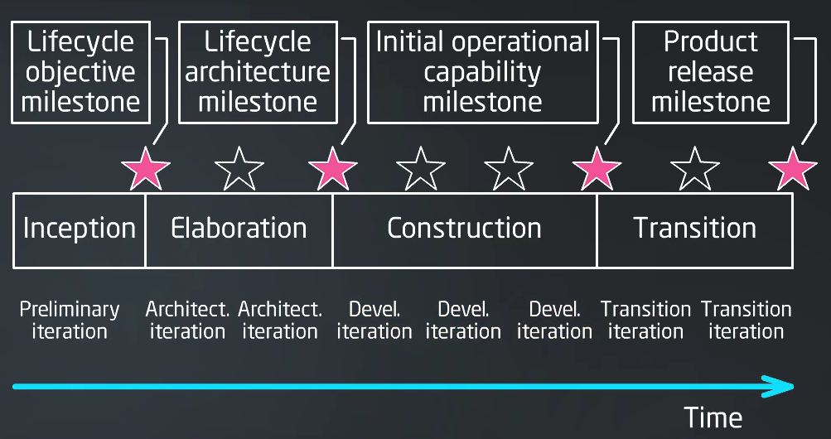
The four phases of RUP

Slide 5
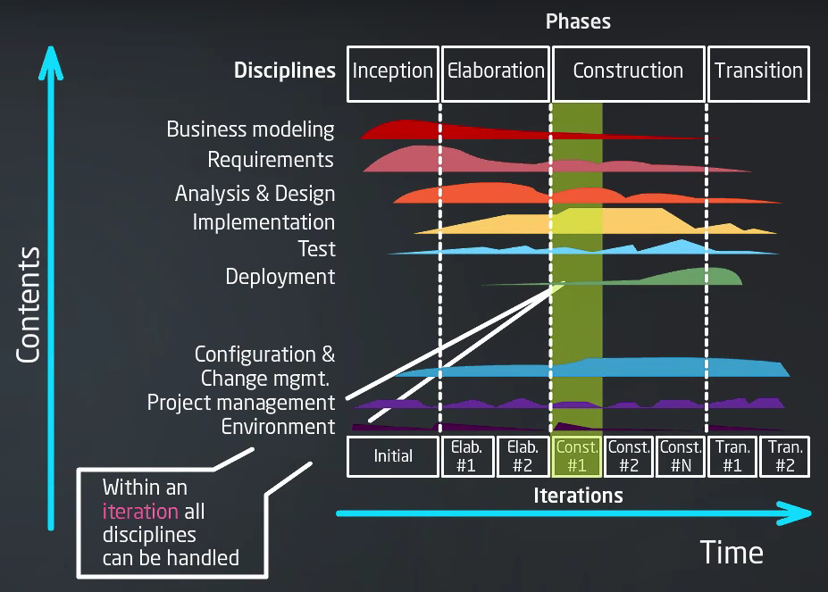

Slide 6
RUP practices
Provide cutomer requirements satisfaction
Concentrate on the program implemented
Adjust to changes since project start
Build a commponent system
Build the foundation of implementable architecture ASAP
Make quality a lifestyle

Slide 7
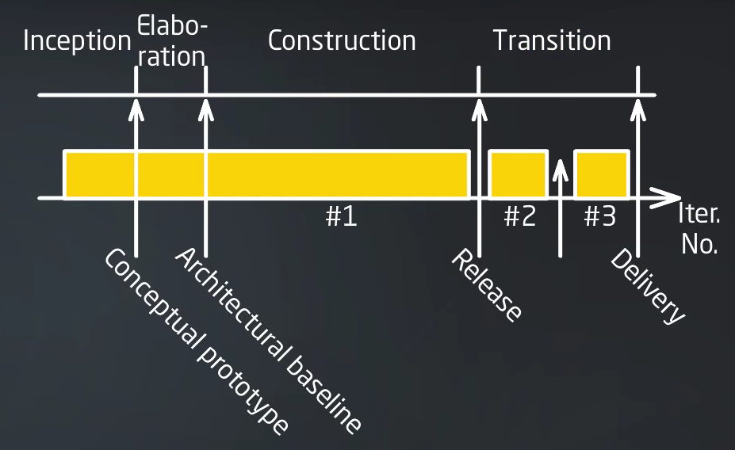
RUP waterfall lifecycle

Slide 8
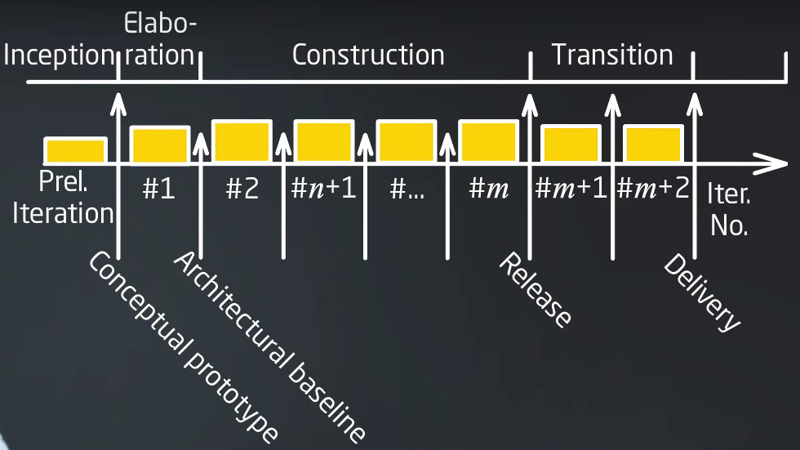
RUP: incremental lifecycle

Slide 9
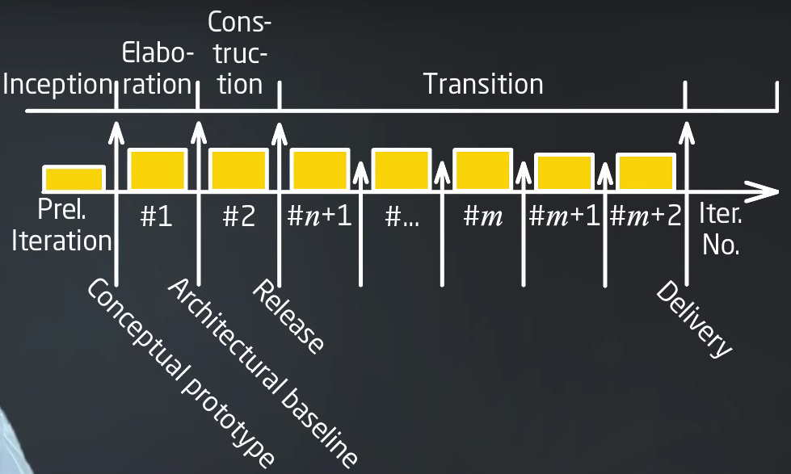
RUP: incremental lifecycle 2

Slide 10
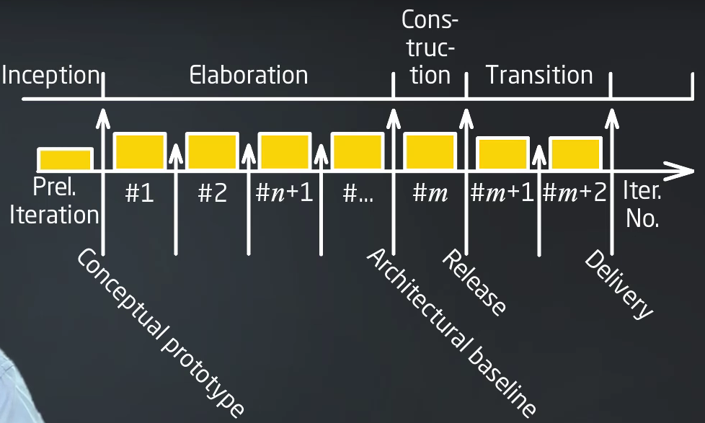
RUP: evolution lifecycle

Slide 11
RUP: organization
RUP is iterative software (SW) development process framework
RUP is organized in phases, iterations and workflows
RUP structure includes roles, activities and artifacts
RUP processes use manuals, patterns and SW user manuals
RUP structure uses workflows of activities
RUP includes a set of best practices

Slide 12
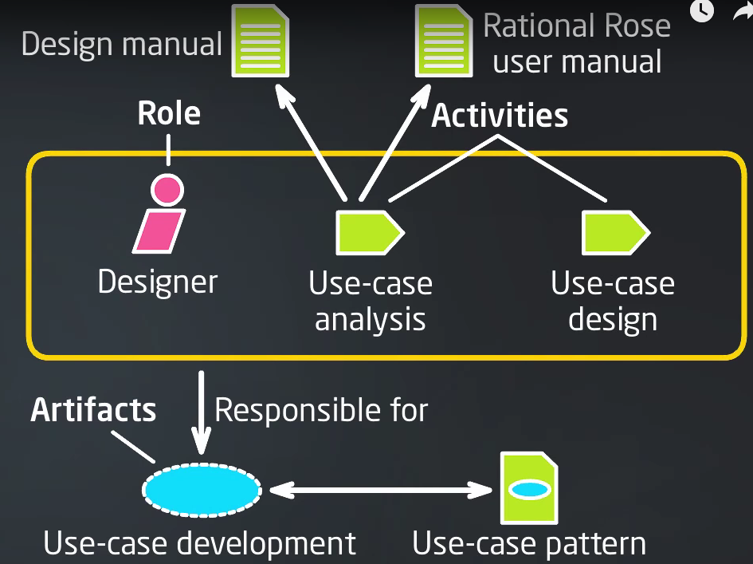

Slide 13
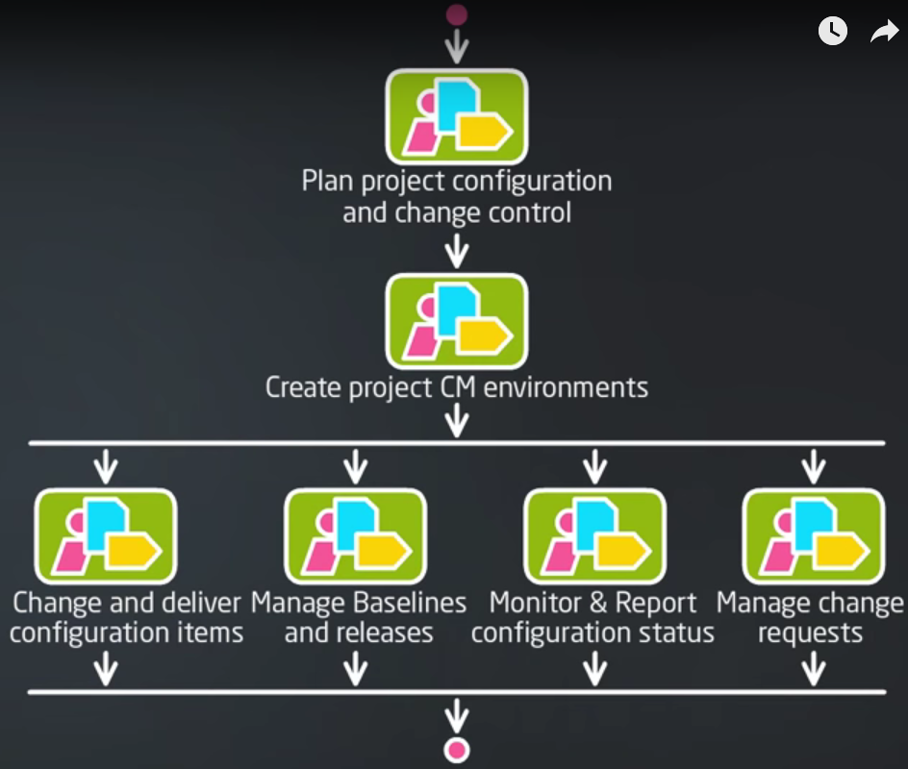

Slide 14
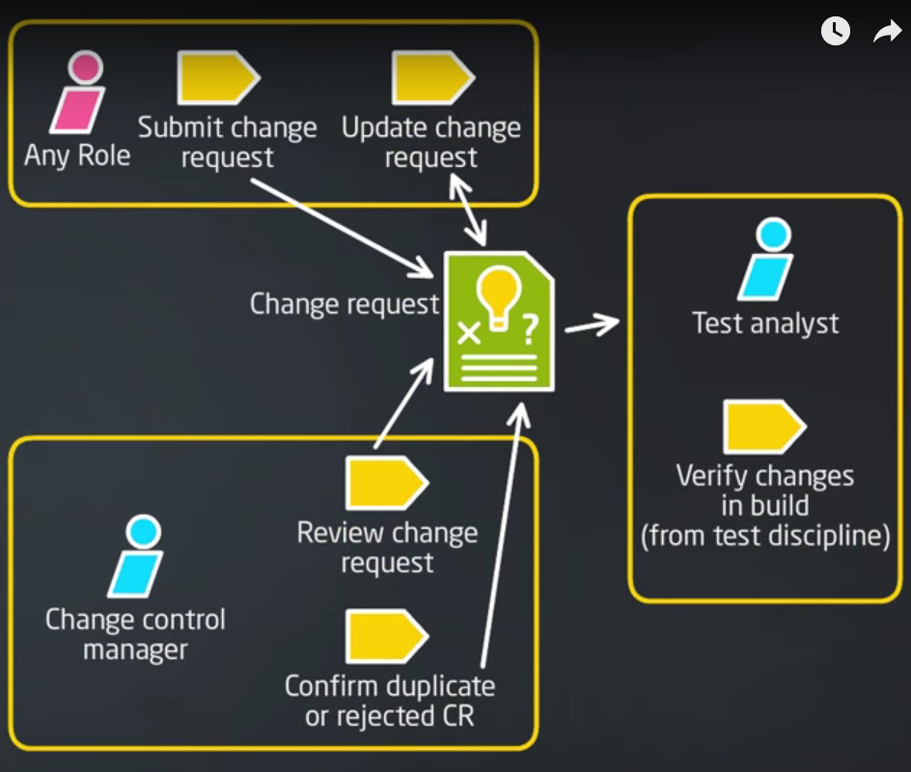

Slide 15
Microsoft Solution Framework
MSF has two implementations:
MSF Agile
MSF Formal
Microsoft Operations Framework (MOF) is an addition
MSF = Build it right
MOF = Run it right

Slide 16
MSF elements
Basic principles
Models for teams and processes
Disciplines of managing
Key concepts (mindsets)
Practices
Recommendations
Meta-model
Implementation for MSF Agile
Implementation for MSF Formal

Slide 17
MSF basic principles
Partnership with client
Foster open communication
Work toward a shared vision
Quality is everyday work for everyone (invest in quality)
Stay agile, expect change
Make implementation a habit
Create value (focus on delivering business value)

Slide 18
MSF basic principles-2
Distribution of responsibility, fixed statements
Empower team members
Focus on business priorities
Single vision of the project
Be flexible - be prepared for change
Encourage free communication
https://ru.wikipedia.org/wiki/Microsoft_Solutions_Framework

Slide 19
MSF roles
MSF project group
Program management
Product management
Development
Testing
Release management
Customer satisfaction
Program manager
Product manager
Developer
Quality Assurance
Release manager
User experience

Slide 20
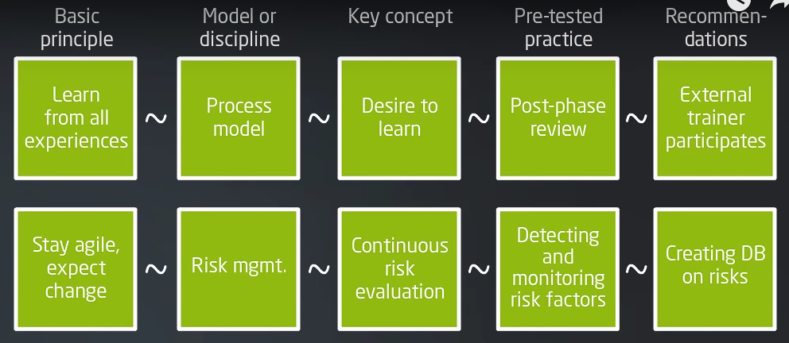
MSF: Elements and Relationships

Slide 21
MSF: teamwork principles
A team of equal
Representing interests of all interested sides
Adjust to match project scale («teams of teams»)

Slide 22
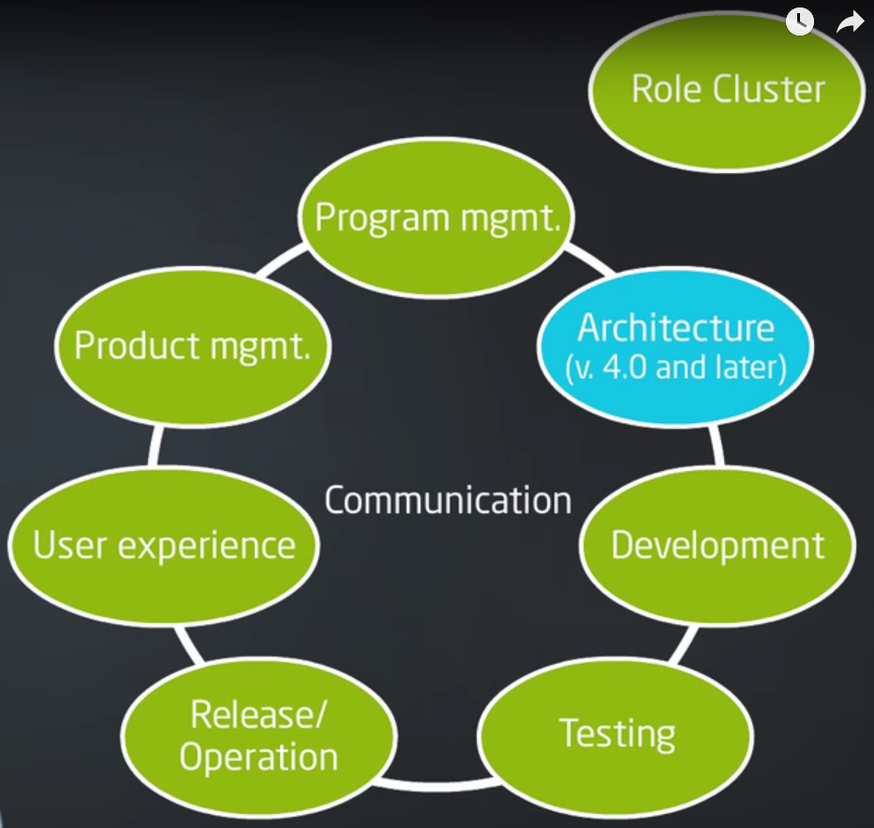
MSF: team model

Slide 23
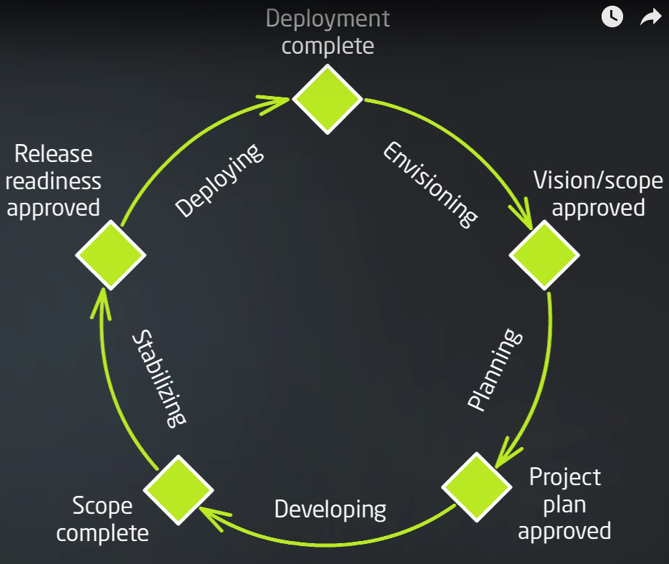
MSF: process model

Slide 24
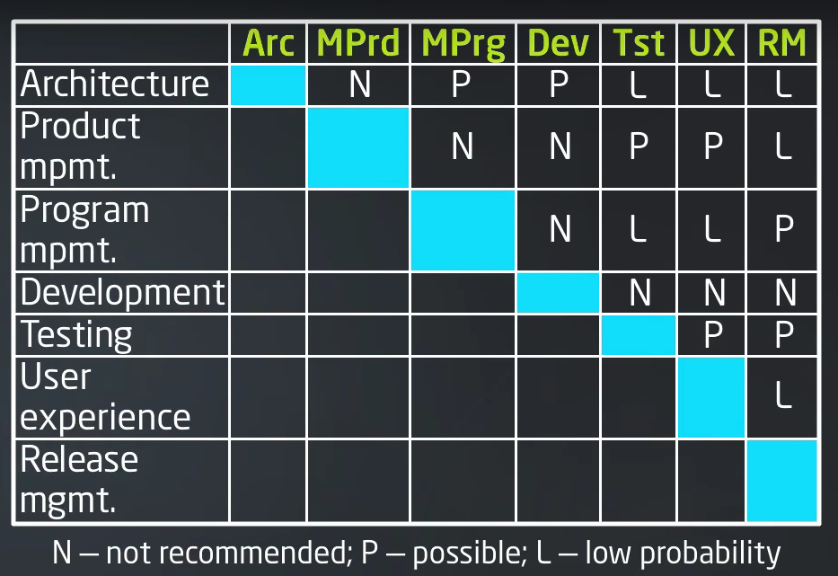
MSF: Role Compatibility Matrix

